Slide 1
Breaking Fantasy Football
Christian Lowson
MSDS Practicum II

Slide 2
Scope of project and presentation
Find a competitive edge to use in fantasy football, an activity I enjoy to do.
It’s essentially educated gambling so, the more education the better.
I am presenting this project as if I was telling the CEO of my company, sports magazine, how we can expand into a new area for customers

Slide 3
How our company can expand into the Fantasy sports market
Sports magazine
Chief idea officer - Christian Lowson

Slide 4
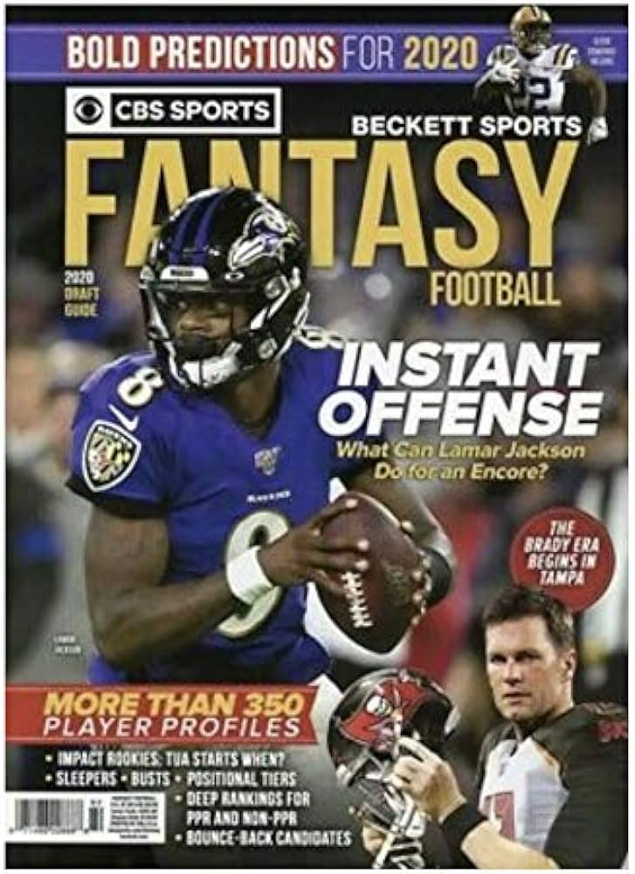
What is the advantage?
We already provide breaking sports news
Our existing market already plays fantasy football
No additional cost for the data or information
Potential to expand into additional sports

Slide 5
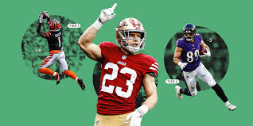
How will we do it?
Utilize our own news and past information from popular fantasy sites
Stay up to date with mock drafts
Proprietary coding algorithm to extract the best data
Readily available testers and population for use

Slide 6



What makes us stand out?
We’ve broken the code
Many fantasy users know the ‘Best practice’
We can offer a competitive edge to users who prescribe to our site
Our data collection offers additional information for decisions

Slide 7
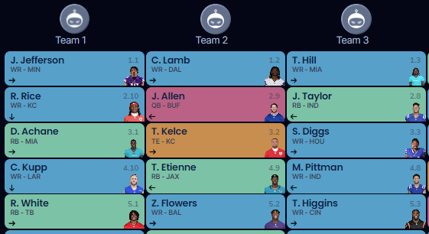
Reminder of Fantasy Football Basics
Typically 10 teams
Each team makes a pick each round
Typically 15 rounds of drafting
Includes a Kicker and a Defense, which we will ignore
Draft order works as a “snake”

Slide 8
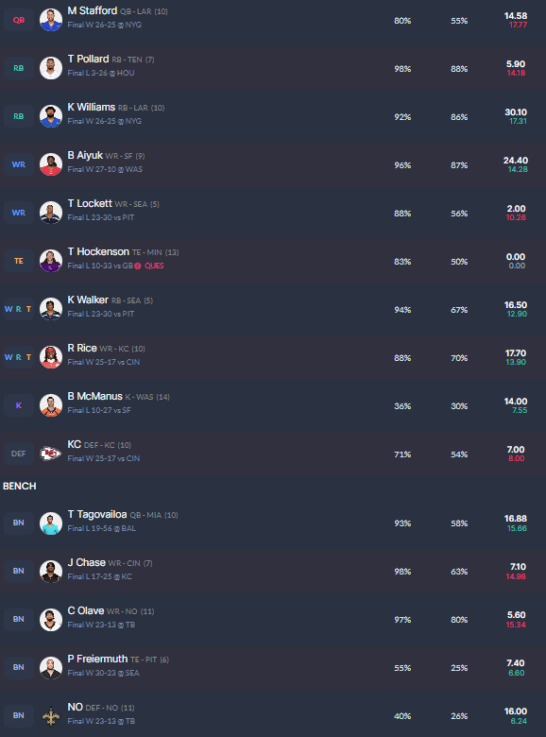
The Usual
The positions that score the most points are WR and RB
You can store up to 5 of each position with a minimum of 2
Some TE’s and some QB’s are particularly high scoring
A lot of variance

Slide 9
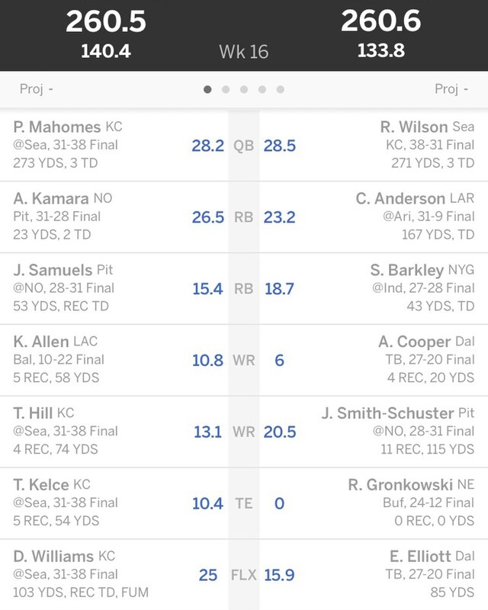
Scoring
Total points from game
Each week your players accumulate points based how they do in games
You set a “lineup” of ~7-9 offensive players weekly
QB’s have an adjustment to scoring, significant for our purpose
Every 1 TD = 6 points
Every 10 yds = 1 point
Every 1 Catch = 1 point

Slide 10
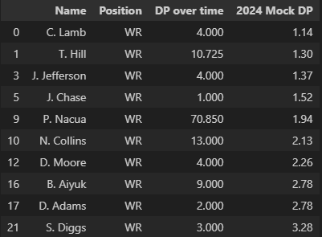
The game is changing
Our customers are smart and experienced
They know how Football changes over time
We still explain it to them

Slide 11
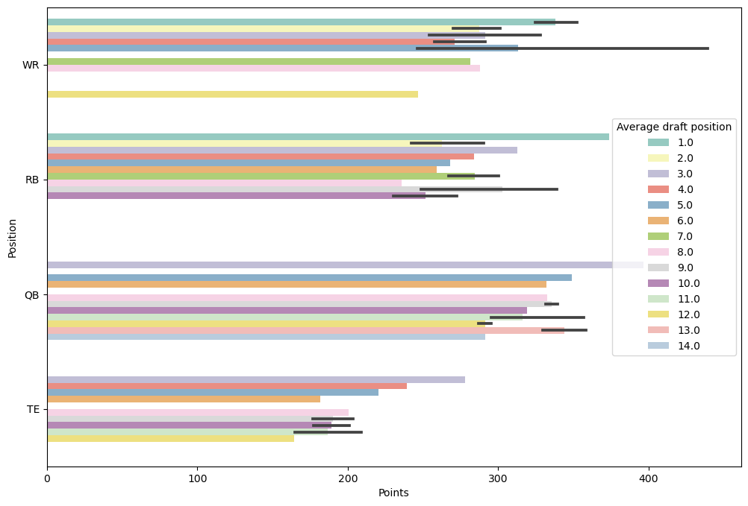
Round 1 and 2
We target a Wide Receiver in the first two rounds
Data shows WR’s are taken the most in rounds 1 and 2
Consistently, WR’s score the most average points in a season

Slide 12
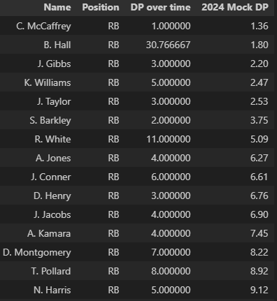
Round 3
We grab a Running back!
Many RB’s fall to the 3rd round and beyond
This year is a bit different from the last few

Slide 13
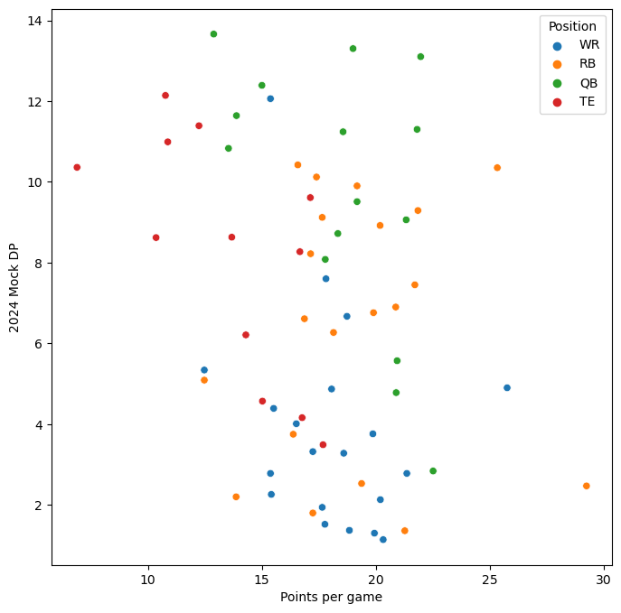
Round 4, 5, and 6
Less strict on what to select here
Assuming past directions were followed
2nd RB, 3rd WR or 3rd RB, & 1st QB will do us well here
Scattering suggest at least a RB with option of WR, QB, and TE
Which order depends on pace of draft
Each draft is different as people tend to take risks, users must match the flow

Slide 14
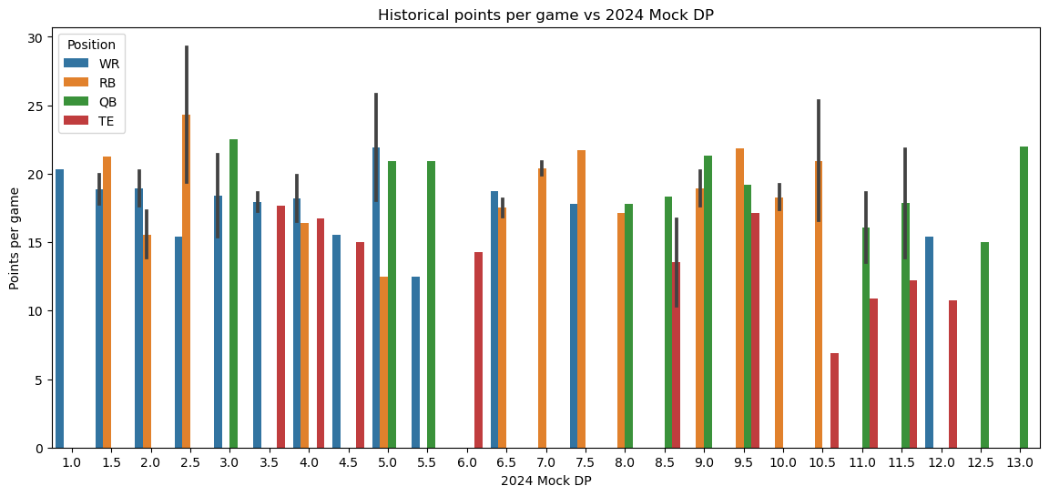
Rounds 7 and later
TE’s start going after round 4, but again late
We fill in additional WR’s, RB’s from here
TE is a known less impact position
QB’s are around late can be pivotal, usually take 2

Slide 15
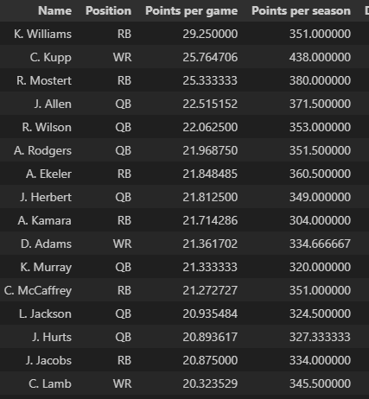
Other factors, Points!
List of highest scoring players per game the last 4 years
Some have only played 1 year
Two of the most commonly picked players are near the bottom
This is common, but to be considered

Slide 16
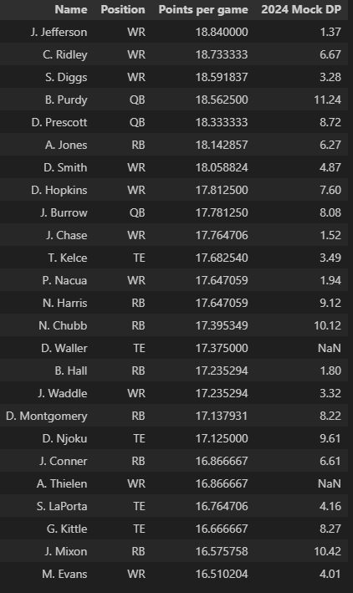
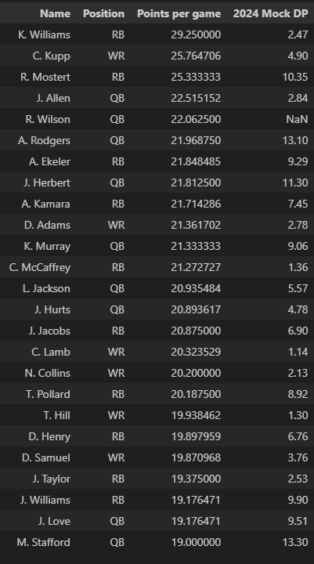
Top 50
Scoring athletes
Useful image for the Fantasy Savvy
Points are the end all, Draft position is timing
In the end, the user must adapt to the draft

Slide 17
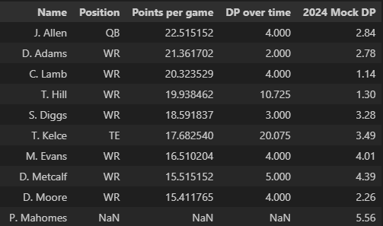
Special Finding
A small list of players have been in the top 60 offensive producers 4 years straight
Consistency is key when playing fantasy football, and targeting these players may just give you the advantage
Mostly WR’s but a good mix

Slide 18
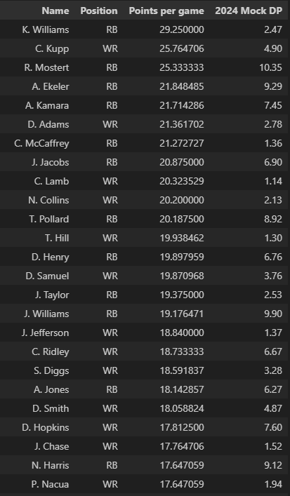
Takeaways
By the end of the 5th round you should have at the minimum 2 WR’s and 2 RB’s
Emphasis on round 1 and 2 WR
From this list of players, after the 3rd round you should have at least 3 of them

Slide 19
Breaking Fantasy Football
Thank you for listening!
Christian Lowson
https://github.com/Christian-Lowson/Regis-MSDS

